Slide 1
Cluster Computing
Dr. Shakti Mishra

Slide 2
History
The first inspiration for cluster computing was developed in the 1960s by IBM as an alternative of linking large mainframes to provide a more cost-effective form of commercial parallelism.
Cluster computing did not gain momentum until the convergence of four important trends in the 1980s:
high-performance microprocessors,
high-speed networks, and
standard tools for high performance distributed computing.
increasing need of computing power for computational science and commercial applications coupled with the high cost and low accessibility of traditional supercomputers.

Slide 3
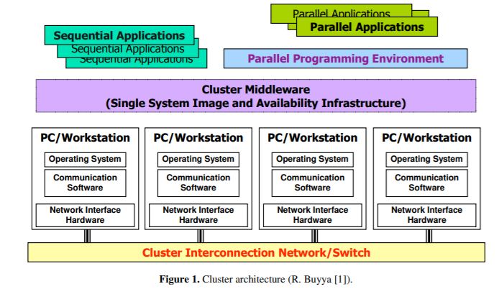
Cluster Architecture

Slide 4
Advantages
The emergence of cluster platforms was driven by a number of academic projects, such as Beowulf [2], Berkeley NOW [3], and HPVM [4]
Advantages of Cluster Computing:
low-entry costs to access supercomputing-level performance,
the ability to track technologies,
incrementally upgradeable system,
open source development platforms, and
vendor independence

Slide 5
Cluster Computing: Definition & Components
A cluster is a type of parallel or distributed computer system, which consists of a collection of interconnected stand-alone computers working together as a single integrated computing resource.
The key components of a cluster include multiple standalone computers (PCs, Workstations, or SMPs), operating systems, high-performance interconnects, middleware, parallel programming environments, and applications.

Slide 6
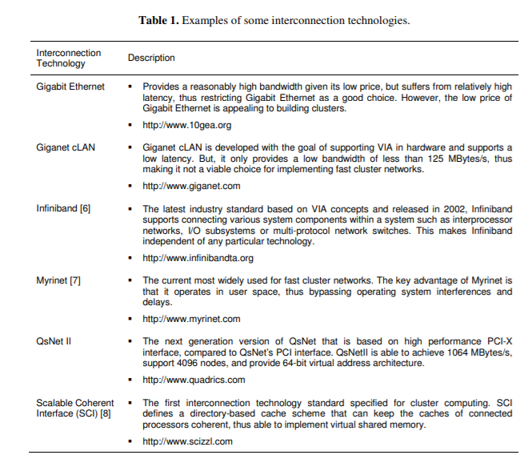
Cluster: Interconnection Technologies

Slide 7
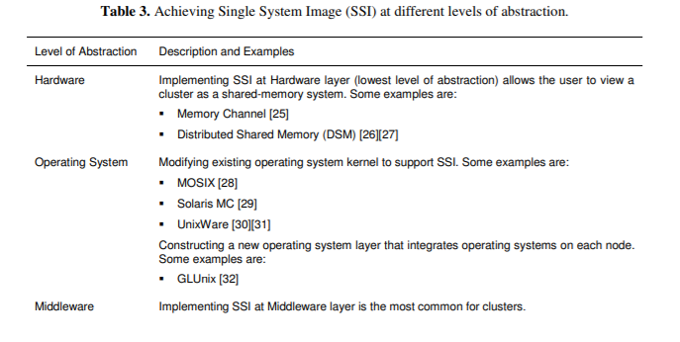
Single System Image (SSI)
Represents the view of a distributed system as a single unified computing resource.
Provides better usability for the users as it hides the complexities of the underlying distributed and heterogeneous nature of clusters from them.
SSI can be established through one or several mechanisms implemented at various levels of abstraction in the cluster architecture: hardware, operating system, middleware, and applications

Slide 8
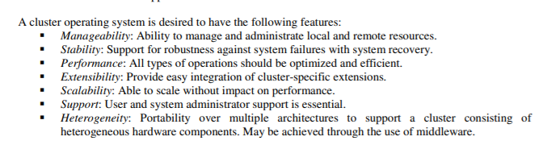
SSI at OS Level
The operating system in each of the cluster nodes provides the fundamental system support for the combined operation of the cluster.
The operating system provides services such as protection boundaries, process/thread coordination, inter-process communication, and device handling, thus creating a high-level software interface for user applications

Slide 9
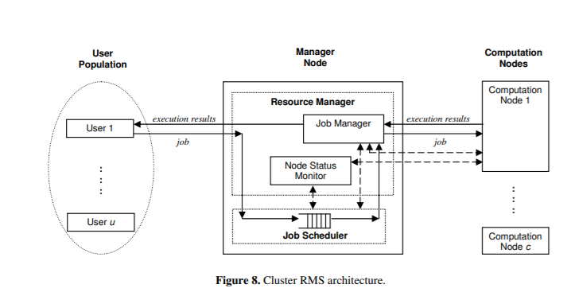
Resource Management System (RMS) Middleware
A cluster resource management system (RMS) acts as a cluster middleware that implements the SSI [24] for a cluster of machines.
It enables users to execute jobs on the cluster without the need to understand the complexities of the underlying cluster architecture.
A RMS manages the cluster through four major branches, namely: resource management, job queuing, job scheduling, and job management.

Slide 10
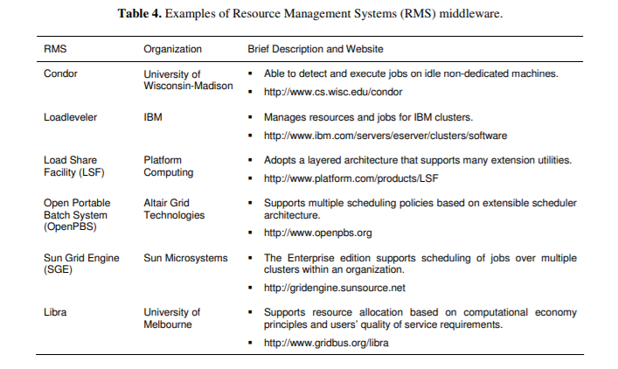
RMS Middleware

Slide 11
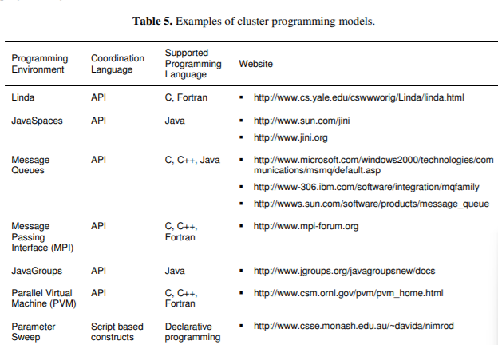
Cluster Programming Models
Cluster computing programming models have traditionally been divided into categories based on the relationship of programs to the data the programs operate on:
The Single-Instruction, Single-Data (SISD) model defines the traditional von Neumann computer.
each processor executes the same program
Multiple-Instruction, Multiple-Data (MIMD) machines.
In the Single-Instruction, Multiple Data (SIMD) model.
multiple programs operate on the same data.

Slide 12
Cluster Programming Models
Programming models can also be categorized on how they exploit a cluster’s inherent parallelism.
cluster computing programming models can roughly be divided in two categories:
The first category of models allow a serial (non-parallel) application to take advantage of a cluster’s parallelism.
The second category of programming models aid in the explicit parallelization of a program.
In SPPS (serial program, parallel subsystem), many instances of a serial program are distributed on a cluster.
A parallel subsystem provides input to each serial program instance, and captures output from those programs, delivering that output to users.
Because there are multiple programs on the clusters, operating on multiple data, SPPS is a form of MIMD.

Slide 13
Cluster Programming Models
When many instances of a serial program operating in parallel, those instances must coordinate work through a shared cluster resource, such as distributed shared memory or a message passing infrastructure.
The primitive operations that coordinate the work of concurrently executing serial programs on a cluster define a coordination language.
A coordination language is often described in terms of an Application Programming Interface (API) to a parallel subsystem

Slide 14
Example: LINDA
The Linda tuple-space system exploits distributed shared memory to facilitate the parallel execution of a serial program on a cluster.
Linda defines primitive operations on a shared memory resource, allowing data items – “tuples” – to be written to that memory, read from shared memory, and deleted from shared memory.
A tuple is similar to a database relation.
A serial process with access to the shared memory writes data items to memory, marking each item with an attribute indicating that that item requires processing.
Another process awaiting newly arriving tuples removes such an item from the shared memory, performs computations on that data item, and deposits the results into the shared memory.
The original submitter of the job then collects all the results from the tuple-space.
Each process operating on a tuple-space is typically a serial program, and the Linda system facilitates the concurrent execution of many such program

Slide 15
Example: JAVASPACES
JavaSpaces is an object-oriented Linda system that takes advantage of Java’s platform-independent code execution and mobile code facility.
Mobile code allows not just data, but also code to move from one cluster node to another at runtime.
A master node runs a JavaSpace process, providing a shared memory resource to other cluster nodes that act as workers.
When a worker removes a job request from the shared JavaSpace, the operating codes for that job dynamically download to that worker. The worker executes that downloaded code and places the output of that execution into the JavaSpace.
JavaSpaces, therefore, facilitates the automatic runtime distribution of code to cluster nodes.
JavaSpaces also provides optional transactional access to the shared memory resource, which is especially helpful in the case of very large clusters with frequent node failures

Slide 16
Case Study: Google Search Engine
Google uses cluster computing to meet the huge quantity of worldwide search requests that comprise of a peak of thousands of queries per second.
A single Google query needs to use at least tens of billions of processing cycles and access a few hundred megabytes of data to return satisfactory search result.
Google uses cluster computing as its solution to the high demand of system resources since clusters have better price-performance ratios than alternative high-performance computing platforms and use less electrical power.
Google focuses on 2 important design factors: reliability and request throughput.

Slide 17
Case Study: Google Search Engine
Google is able to achieve reliability at the software level so that a reliable computing infrastructure can be constructed on clusters of 15,000 commodity PCs distributed worldwide.
The services for Google are also replicated across multiple machines in the clusters to provide the necessary availability.
Google maximizes overall request throughput by performing parallel execution of individual search requests. This means that more search requests can be completed within a specific time interval.

Slide 18
Case Study: Google Search Engine
A typical Google search consists of the following operations:
1. An Internet user enters a query at the Google webpage.
2. The web browser searches for the Internet Protocol (IP) address via the www.google.com Domain Name Server (DNS).
3. Google uses a DNS-based load balancing system that maps the query to a cluster that is geographically nearest to the user so as to minimize network communication delay time. The IP address of the selected cluster is returned.
4. The web browser then sends the search request in Hypertext Transport Protocol (HTTP) format to the selected cluster at the specified IP address.
5. The selected cluster then processes the query locally.
6. A hardware-based load balancer in the cluster monitors the available set of Google Web Servers (GWSs) in the cluster and distributes the requests evenly within the cluster.
7. A GWS machine receives the request, coordinates the query execution and sends the search result back to the user’s browser.

Slide 19
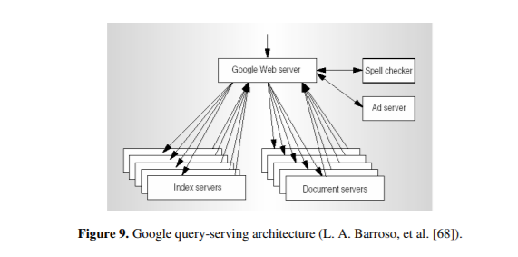
Case Study: Google Search Engine
The first phase of query execution involves index servers consulting an inverted index that match each query keyword to a matching list of documents.
Relevance scores are also computed for matching documents so that the search result returned to the user is ordered by score.
In the second phase, document servers fetch each document from disk to extract the title and the keyword-in-context portion of the document.
In addition to the 2 phases, the GWS also activates the spell checker and the ad server.
The spell checker verifies that the spelling of the query keywords is correct, while the ad server generate advertisements that relate to the query and may therefore interest the user

